Slide 1
KLG Europe
Your France specialist | 2026

Slide 2

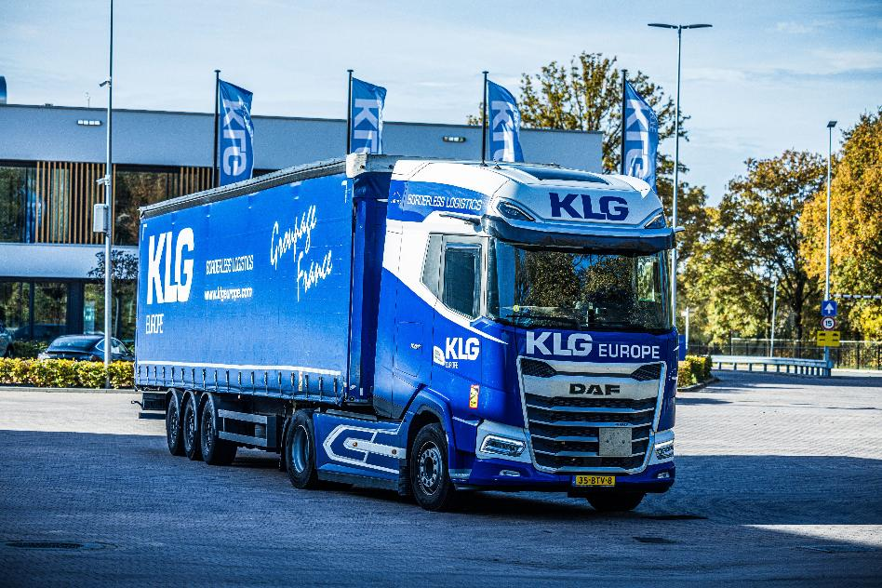
KLG EUROPE - EERSEL
Daily transportation services Netherlands – France and France – Netherlands for groupage, LTL, (FTL)
550 departures per week
Direct pick up and delivery without x-docking
Own trucks equipped with state of the art technology
Pallet System distribution with online Track & Trace, including POD
Track & Trace
Performance Reporting / KPI
Dedicated operations
French speaking Customer Service

Slide 3
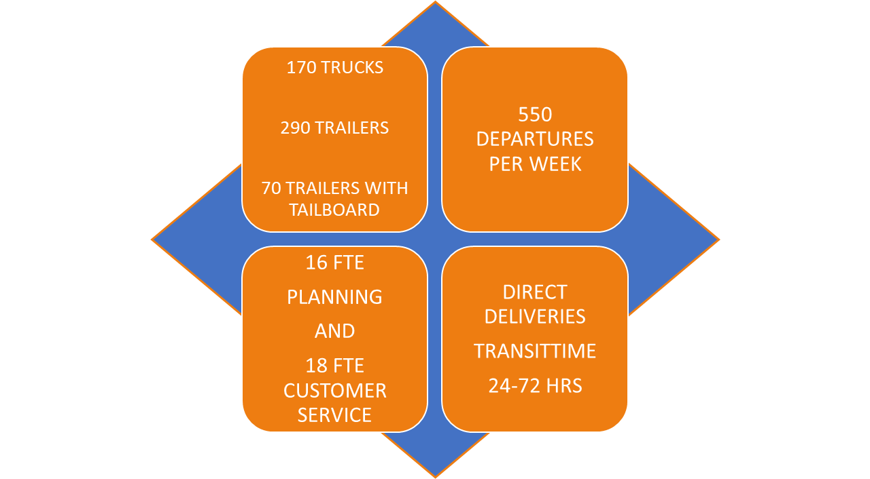
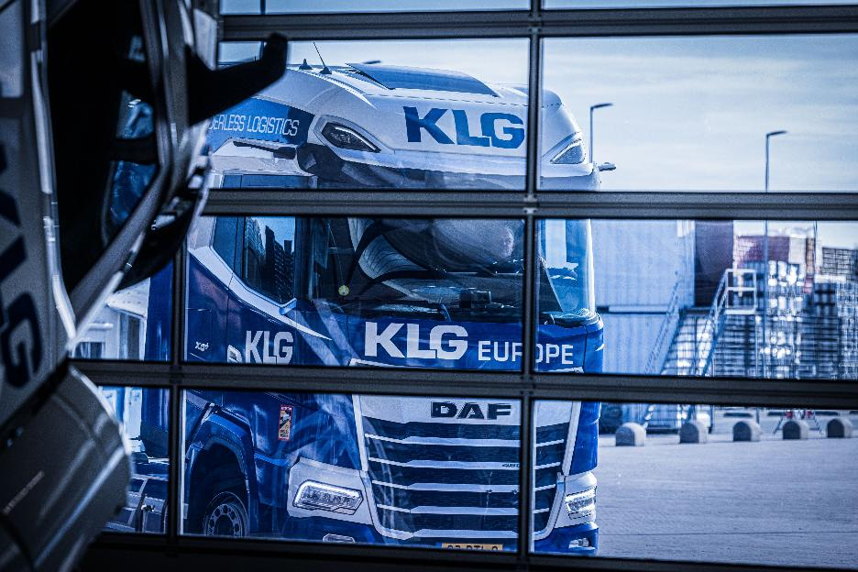




YOUR FRANCE SPECIALIST

Slide 4
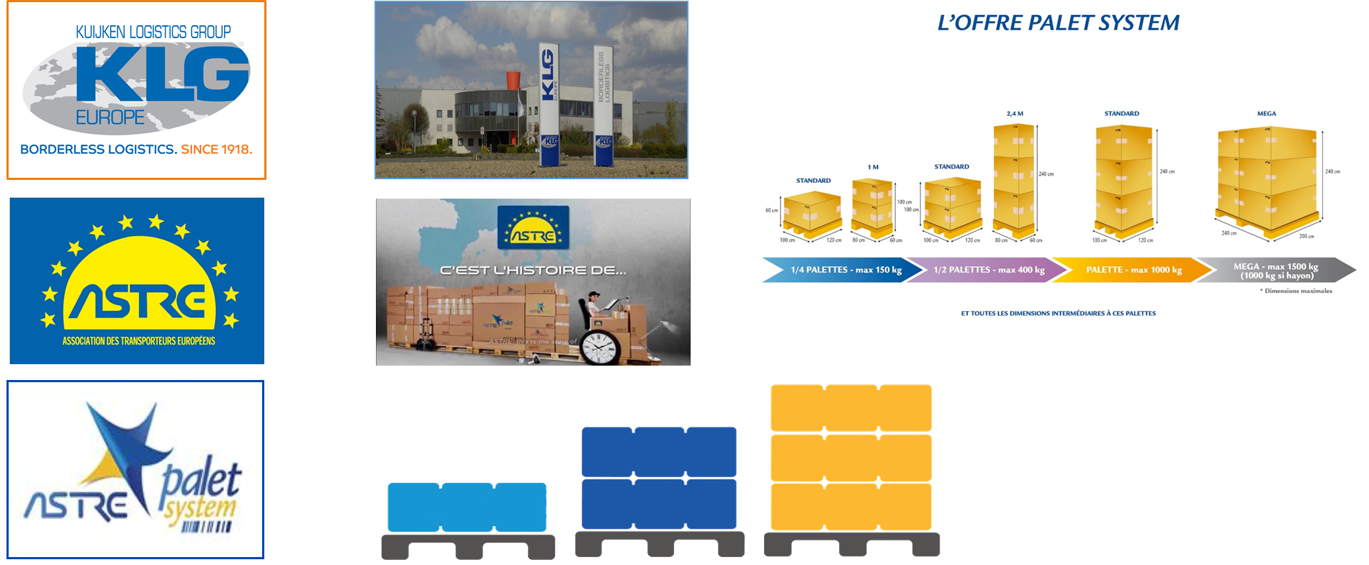
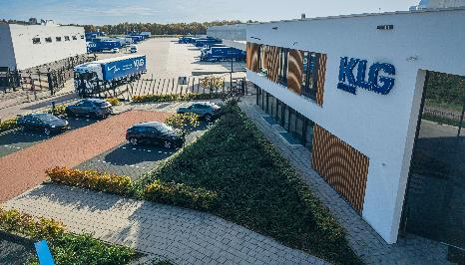


SYSTEM DISTRIBUTION FRANCE

Slide 5
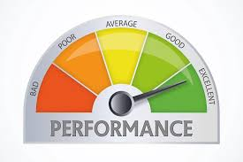
SYSTEM DISTRIBUTION FRANCE
OUR STRENGTHS
Total coverage of the country
60 Distributors spread geographically throughout France
6 Regional Platforms:
Paris – Niort – Lyon – Clermont – Agen - Langres
8 European Platforms :
Germany, Belgium, Spain, United Kingdom, Ireland, Italy, Austria, the Netherlands
Traceability and Reliability
Fully integrated IT system
Track and Trace of product in transit
Constant monitoring of the quality in Astre network
For more information you can visit: www.paletsystem.com
ASTRE NETWORK
SUCCESS RATE 2025:
99.02% OTIF

Slide 6
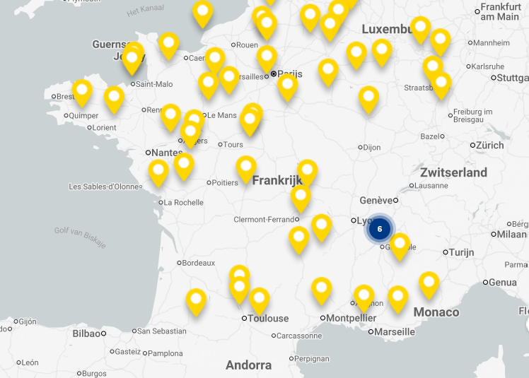
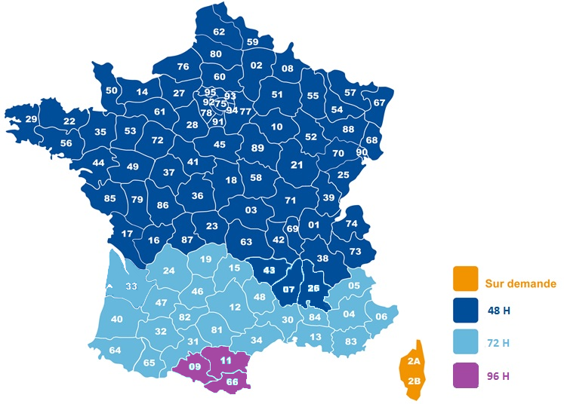
SYSTEM DISTRIBUTION

Slide 7
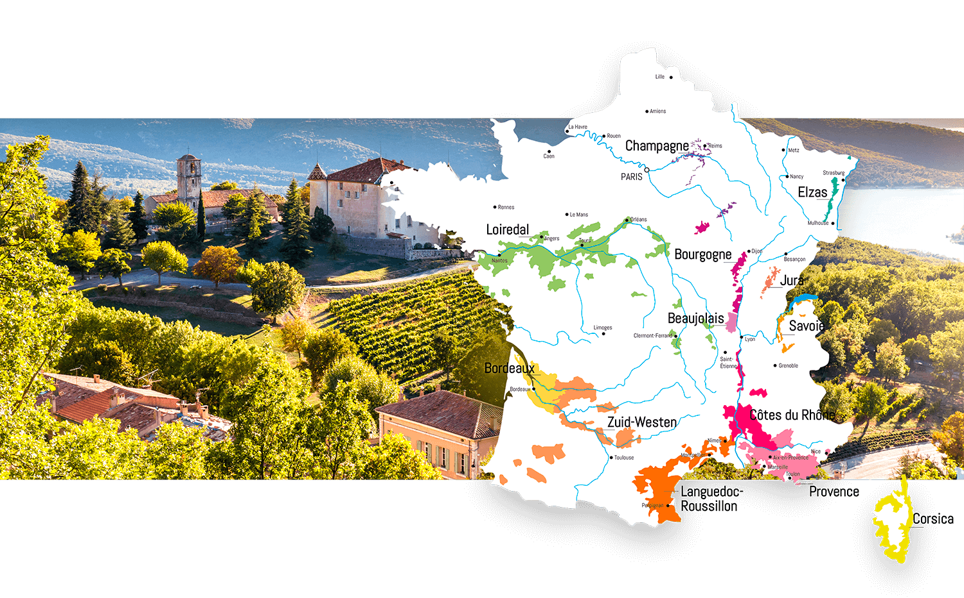
WINE TRANSPORT FRANCE - NETHERLANDS

Slide 8
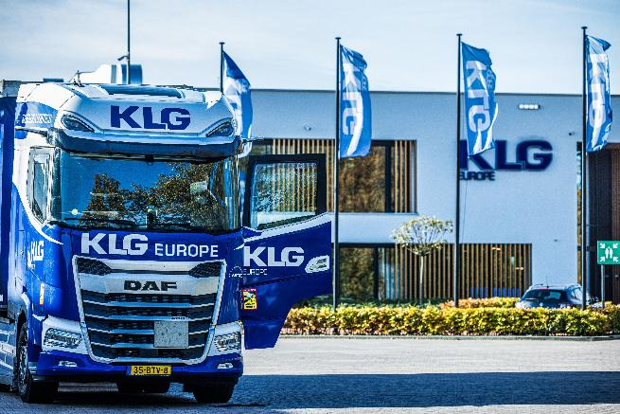
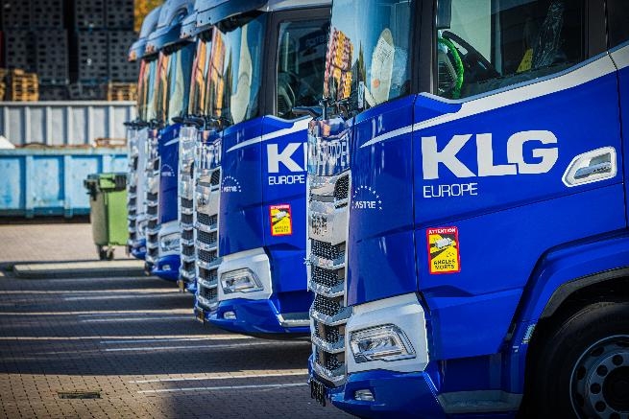
WINE TRANSPORT FRANCE - NETHERLANDS
Daily departures from all regions in France
Direct pick up and delivery from 1 pallet up to FTL
Experienced drivers familiar with Chateaux and Domaines
French speaking Customer Service
Dedicated wine planning
Pallet exchange
Know-how French culture

Slide 9

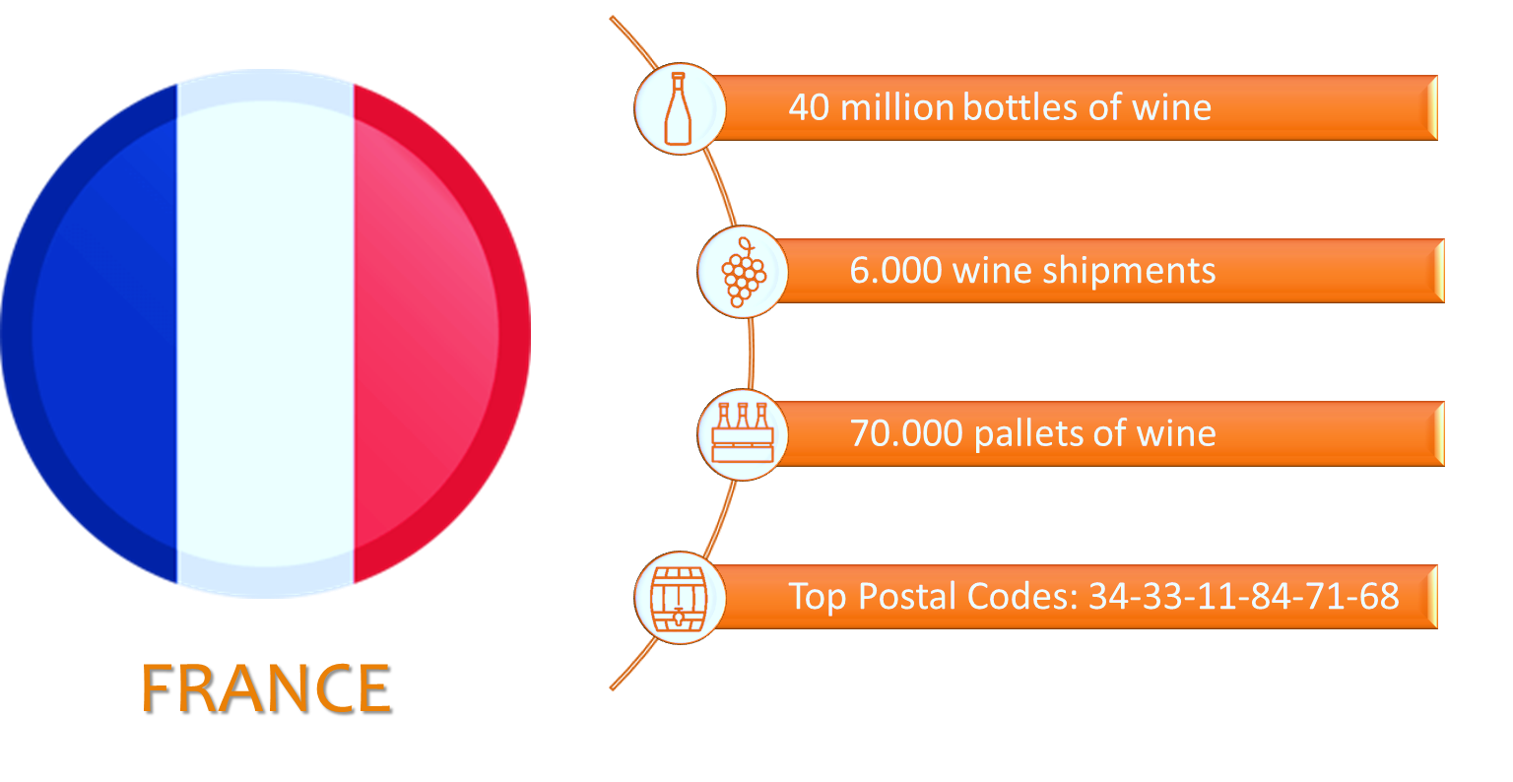
WINE FIGURES - 2025
FRANCE

Slide 10


Corporate social responsibility
Green Logistics
Reduction CO2 emission
Fuel consumption checks on all vehicles and drivers
All trucks EURO 6
Eco driving training for drivers
Transport modality
Green IT
Occupational safety and health
Steady course - financially solid
Social innovation

Slide 11




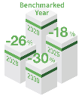
Corporate social responsibility
4 INTEGRATION
3 BIO FUEL
1 GEORGE
Focus on sustainability projects
Foundation of our company; the employees
Sustainable processes on all levels of our business aligned with our mission high-quality
Better and more sustainable future for everyone
Using Biofuel to achieve our CO2 reduction targets
Book & Claim product in Q1 2024 available for customers
We are exploring more innovative alternatives for sustainable transport
Consolidating sustainability goals and milestones
Core values: Green, Economy, Organization, Respect, Growth, and Ethics.
Key aspects of our business, employees, customers, suppliers, environment, community & education, certificates, and code of conduct.
5 REFLECT
2 GOALS
We take our responsibility
Setting goals; reflect, evolve and adapt
Together is core value, concept of teamwork
A sustainable future: Our Plan for Zero Logistics Emissions
Goal: our efforts are not only for our own benefit, but for the benefit of current and future generations.

